Slide 1
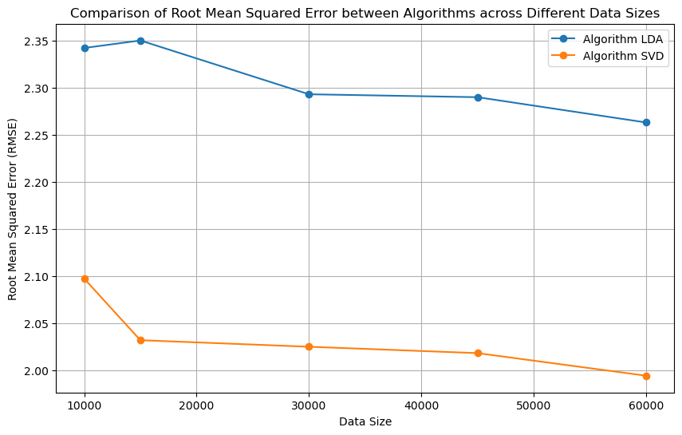
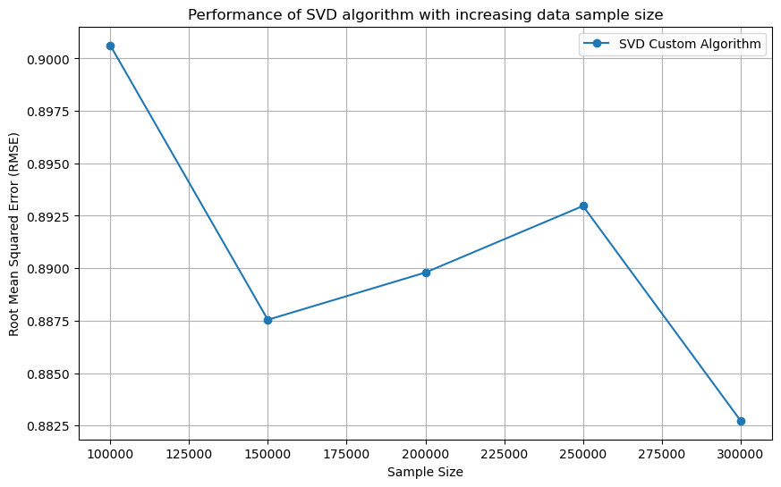

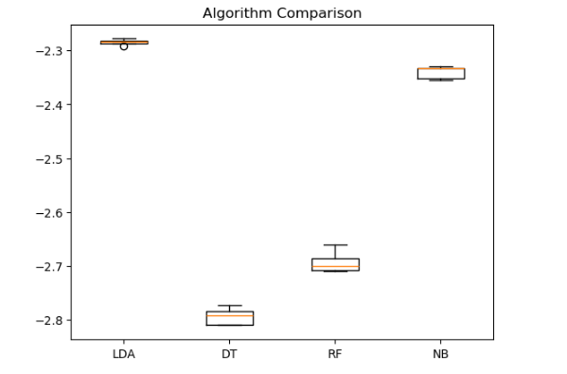
Capstone Project
Movie recommendation System
Ingrid Castro and Robert Szlufik, CCT College Dublin, May 2024
ABSTRACT
Stage 2 – Data Understanding
From the models tested we chose to optimise the best of them, the LDA, and then compare it with the performance of another algorithm: SVD. This algorithm, also known as Singular Value Decomposition, is effective and commonly used in recommendation systems. We then put the results in a graph and even the initial results were already quite satisfactory:
This project is focused on implementing a Movie Recommendation System with the use of Machine Learning. The system was developed in Python and the datasets used were 'Movies' and 'Ratings' from MovieLens 25M. This project was developed with the CRISP-DM methodology and each of the phases is detailed in a report and Jupyter Notebook.
The system is a hybrid combining best qualities of collaboration filtering and user grouping. In the project we compare some models accuracies, upgrade a chosen model and show the improved performance of our hybrid model, that used the SVM algorithm. We are able to find recommended movies based on user ratings.
On our Data Understanding phase we determined that we would be working with two datasets from Movielens 25M: 'Movies' and 'Ratings'. The specifics of each dataset were:
‘Movies’ dataset contains 62.423 rows and 3 columns;
Columns are: ‘movieId’ (int64), ‘title’ (object) and ‘genres’ (object);
No duplicate values;
No null values;
No NA values;
'Ratings' dataset contains 25.000.095 rows and 4 columns;
Columns are: 'userId' (int64), 'movieId' (int64), 'rating' (float64), 'timestamp' (int64);
No duplicate values;
No null values;
No NA values;
The data quality of these datasets was very good and allowed us to do some Data Preparation mostly to prepare data for modelling, not to deal with missing values and/or null or NA values. Data visualisations were also included on the report.
RESEARCH OBJECTIVES
The two objectives below represent the core focus of the entire project:
Objective 1: Develop a system that provides accurate movie recommendations for users, with minimal time needed to produce them.
Objective 2: Create a working prototype for our recommendation system.
Stage 3 – Data Preparation
Fig 4.2 - Comparison of RMSE on LDA and SVD in different data sizes
CONCEPTUAL FRAMEWORK
In the Data Preparation phase we started preparing the data for our fourth phase (Modelling). Since there was no need for dealing with missing, NA and null values, we focused our efforts in getting more numerical variables from our categorical ones.
For 'movies' we encoded the genres, adding 19 new columns with int64 being its datatype. We also added the 'genre_count' column, as int64 and the 'year' column also as int64.
For 'ratings' we dropped the 'timestamp' column.
We then merged the datasets, excluding the 'genres' column and having a dataset called 'merged' with 25 columns and 25M rows.
After that we were moving back and fourth on modelling and data preparation phases, since we would always get to train/ test/ split the data and scale it as we see fit.
When the decrease of Root Mean Square Error was observed within bigger data sizes we decided to do further testing to assure that the decreasing trend would maintain its descent and that the quality of the model would increase. This is how the model performed with sample sizes of a 100k to 300k rows:
As our Conceptual Framework we chose Crisp-DM, that is an ideal methodology when dealing with machine learning and data mining projects. It consists of an interactive process where we would define our business goals and what is the market for our product, understand the data, treat and prep it for modelling. After the modelling phase we do an evaluation of the full work and then deploy it, reflecting onto the process as a whole.
Stage 4 - Modelling
For our modelling phase we started thinking about our alternatives in terms of algorithms. We learned about the types of recommendation systems: Collaborative Filtering, Content Filtering, Context Filtering and Hybrid models. It was a discovery process to get to the final result. We tested the performance of Linear Discriminant Analysis (LDA), Decision Tree Regressor (DT). Random Forest Classifier (RF) and Gaussian Classifier (NB), because according to Portugal, Alencar and Cowan (2018) these were the most used algorithms in terms of a recommendation system. We observed how well they performed according to the RMSE (Root Mean Squared Error).
CONCLUSIONS
Fig 4.3 - Increased performance of SVD algorithm on bigger samples.
A summarised answer to the research questions are presented below:
Q.1. Both of the studies on the use of a reflective learning journal were mostly negative, in that students did not find it beneficial, and in some cases, saw it as an additional ungraded piece of assessment .
Q.2. There was evidence to suggest it does, specifically relating to group based activities, and communicating with peers. However, it is difficult to say positive findings were directly linked to the social learning activities introduced over the semester.
Q.3 The use of PBL and PAL was very successful in engaging students in computer programming, the students engaged in the activities and requested more of these activities in the future.
Q.4 There was no strong evidence to suggest social learning improved self-efficacy in computer programming, however, there was strong evidence found that participating in group work enhances self-efficacy in working with others in group activities.
After these results, we trained our final model. There was some data preparation to filter movies with more than 10k ratings (this would allow us to tackle any bias in ratings) and create a final dataset: 'ratings_final'. This was trained and validated and we made a evaluation of its performance as the next phase of our project.
Stage 1 – Business Understanding
Stage 5 - Evaluation
For our business understanding phase we defined our objectives, thought of ours stakeholders and our deliverables. We wanted our model to be accurate, unbiased by the big industries, accessible for the general public and also fill the gap in the movie recommendation industry, that is usually linked with big streaming companies.
In terms of technologies used, we opted for open source solutions and used libraries such as: pandas, numpy, matplotlib, seaborn, sklearn, pickle and tkinter to accomplish our development goals. We also divided our responsibilities so each would participate in every phase of development but would focus in some of them, so we could both develop and deliver this project within a 2-month deadline. On our report we also explore the legal and ethical issues as well as data collection methodology – all according to GDPR and the Digital Services Act.
In the evaluation phase we did the assessment of the results of our final model. We could observe that the testing set had an RMSE of 0.895, while the training set had a 0.891 Root Mean Squared Error – way better than the initial indices of 2.24 for the LDA algorithm and 2.04 for the SVD (in a smaller sample of the data).
With that assessment we are proved that not only the use of the SVD algorithm already upgraded the efficiency of our model in smaller samples of data, but also got even better results at a bigger sample, which is what we have. With that, 0.89 points up or down
REFERENCES
Bandura, A. (1986). Social Foundations of Thought and Action: Social Cognitive Theory. U.S.A: Pearson Education.
Bandura, A. (2006). Guide for constructing self-efficacy scales. In F. Pajares, & T. Urdan (Eds.), Adolescence and education: Vol. 5. Self efficacy and adolescence (pp. 307-337). Greenwich, CT: Information Age.
Bogdan, R.C., Biklin, S.K. (1998). Qualitative research for education: An introduction to theory and methods. (3rd edition). Boston: Allyn and Bacon.
Bryman, A. (2004). Social Research Methods. U.K.: Oxford University Press.
Creswell, J.W., Miller, G.A. (1997). Research Methodologies and Doctoral Process. New Directions for Higher Education, no.99. U.S.A.: Wiley.
Hamir, S., Maion, S., Tice, S., & Wideman, A. (2015) Constructivism in
Education. Available at: http://constructivism512.weebly.com . Accessed 27th February 2018.
Miles, M.B., & Huberman, A.M. (1994). Qualitative data analysis: A sourcebook of new methods. Thousand Oaks, CA: Sage.
Fig 4.1 - Models comparison on RMSE scale.

